Slide 1
Introduction to Convolutional Networks
Gary Cottrell
With some of my own slides, but using many slides developed by:
Rob Fergus
New York University

Slide 2
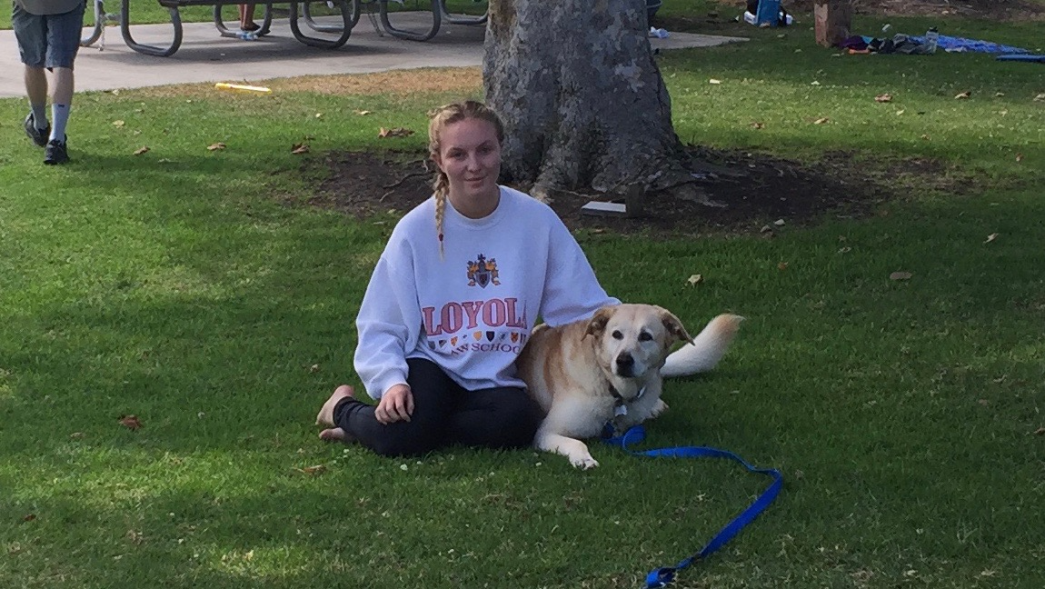
Why convnets
This image is 1140X648 = 745,200 pixels
How many parameters would a standard neural net need?
100 hidden units:
74,520,000 input->hidden weights...

Slide 3
Properties of the visual world
Four important properties:
Nearby pixels depend most on nearby pixels – not pixels far away: locality
On the other hand, the statistics of pixels are relatively uniform across the image: stationary statistics
Identity of an object (usually) doesn’t depend on its location in the image: translation invariance
Objects are made of parts: Compositionality

Slide 4

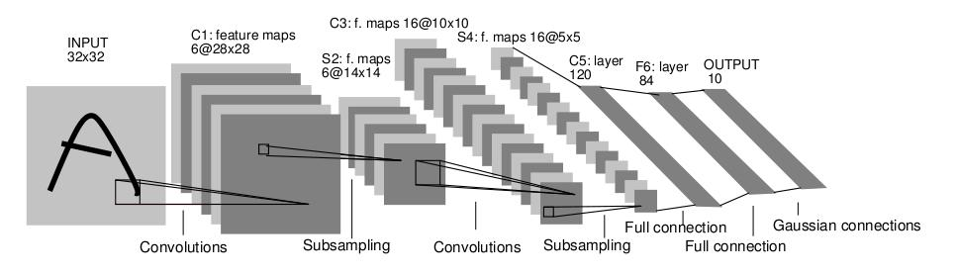
Convolutional Neural Networks
Began with LeCun et al. 1989
Small, local receptive fields and learned features (kernels): locality
These are replicated across the image: stationary statistics
Spatial pooling: translation invariance
Objects are made of parts: receptive fields get larger deeper in the net

Slide 5
Receptive fields
In neuroscience a receptive field refers to both:
The size of the visual world that innervates the neuron
The visual features in that part of the visual world that most stimulate that neuron

Slide 6
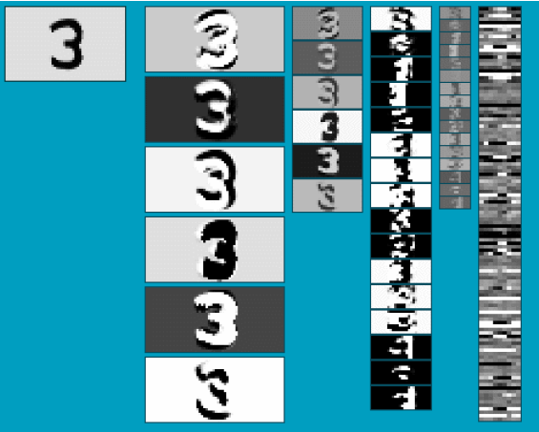
Activation Maps
Six convolutional feature responses
Pooling of those means a 2X2 set of responses -> 1 number (1/4 size)
This means if a feature is in any of four locations – it is now represented by one number – translation invariance
16 convolutional features of the previous layer
Pooling of those
A fully-connected layer
See demo: http://yann.lecun.com/exdb/lenet/index.html
Slide: Y.LeCun
Notes:
Need to bring out differeces wrt to existing ML stuff, mainly unsupervised learning part. Make use of unlabaled data (lots of it).

Slide 7
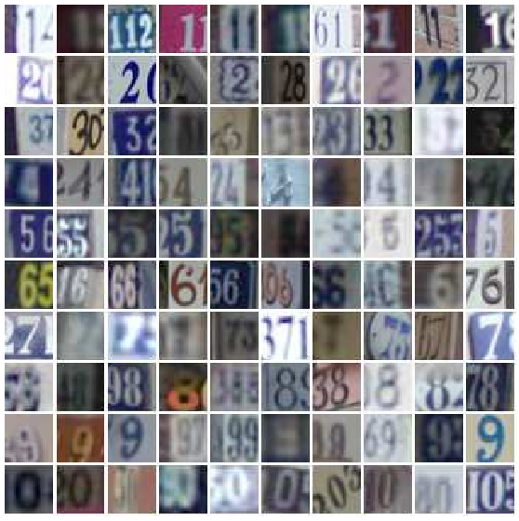
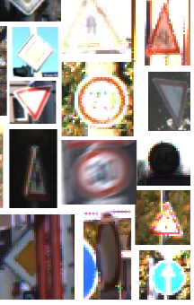
Early Convnet Successes
Handwritten text/digits
MNIST (0.17% error [Ciresan et al. 2011])
Arabic & Chinese [Ciresan et al. 2012]
Simpler recognition benchmarks
CIFAR-10 (9.3% error [Wan et al. 2013])
Traffic sign recognition
0.56% error vs 1.16% for humans [Ciresan et al. 2011]
But less good at more complex datasets
E.g. Caltech-101/256 (not enough training examples)

Slide 8
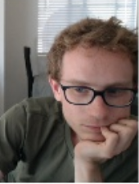

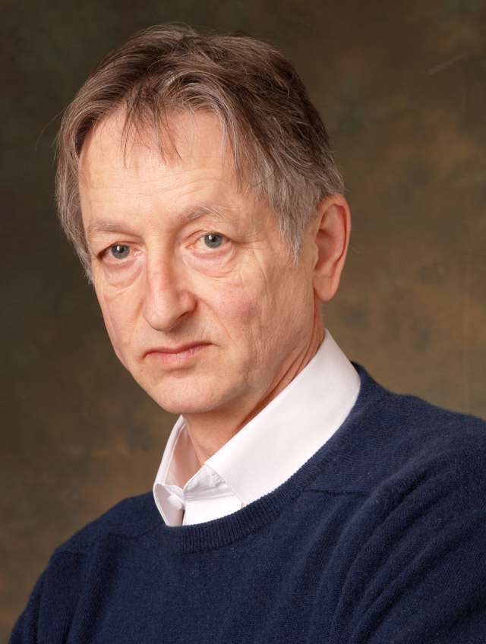
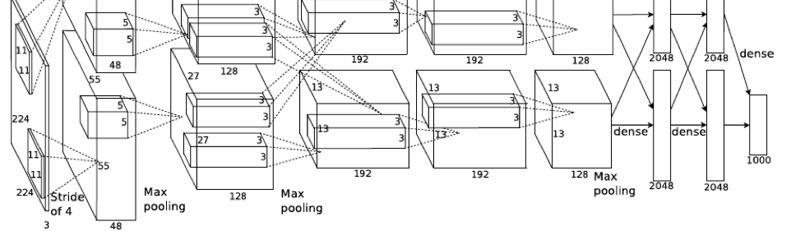
Now, very deep networks
This is a (half of) a network with eight layers of convolutions and pooling units – called “AlexNet” after Alex Krishevsky, Hinton’s student.
Trained with 1.2 million images from ImageNet – to categorize them into 1000 categories

Slide 9
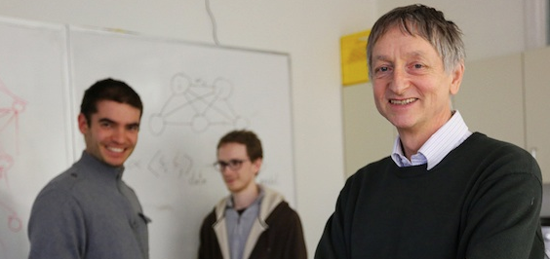
Now, very deep networks (Krizhevsky,Sutskever, & Hinton)
This is a (half of) a network with eight layers of convolutions and pooling units – called “AlexNet” after Alex Krishevsky, Hinton’s student.
Trained with 1.2 million images from ImageNet – to categorize them into 1000 categories

Slide 10

Now, very deep networks (Krizhevsky, Sutskever, & Hinton)
This is a (half of) a network with eight layers of convolutions and pooling units – called “AlexNet” after Alex Krishevsky, Hinton’s student.
Trained with 1.2 million images from ImageNet – to categorize them into 1000 categories

Slide 11
The Imagenet Large Scale Visual Recognition Challenge (ILSVRC)
1.2 Million training images
1000 categories (732-1300 training images per class)
50,000 test images
Large variation in images
Many fine-scale categories (120 dog breeds, not just “dog”)

Slide 12
Goal
Image Recognition
Pixels → Class Label
[Krizhevsky et al. NIPS 2012]

Slide 13
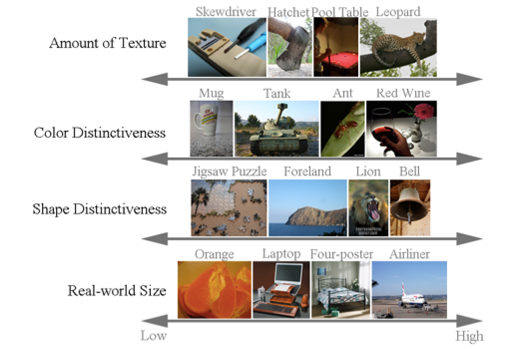
Imagenet: Overall Image Variance

Slide 14
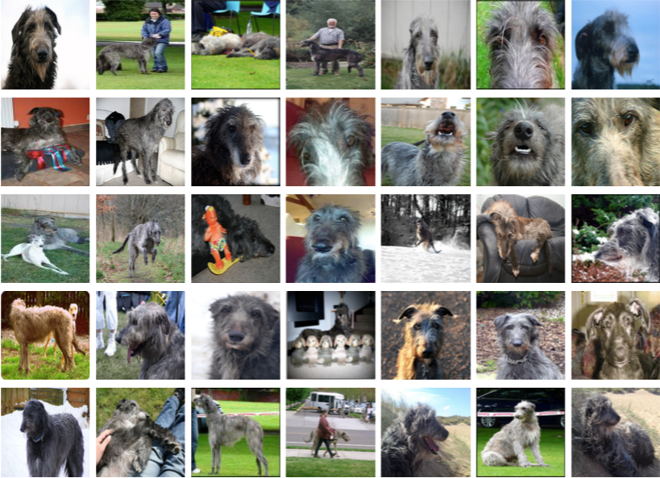
Imagenet: Within-category variance
These are ALL Scottish Deerhounds!
Note how hard it would be for you to learn these!
Notes:
Scottish Deerhound

Slide 15
Why Deep Learning
“Standard” computer vision approaches

Slide 16
Why Deep Learning
ERROR RATE
Deep neural network
(AlexNet)
Notes:
The GAP is HUGE!!!

Slide 17
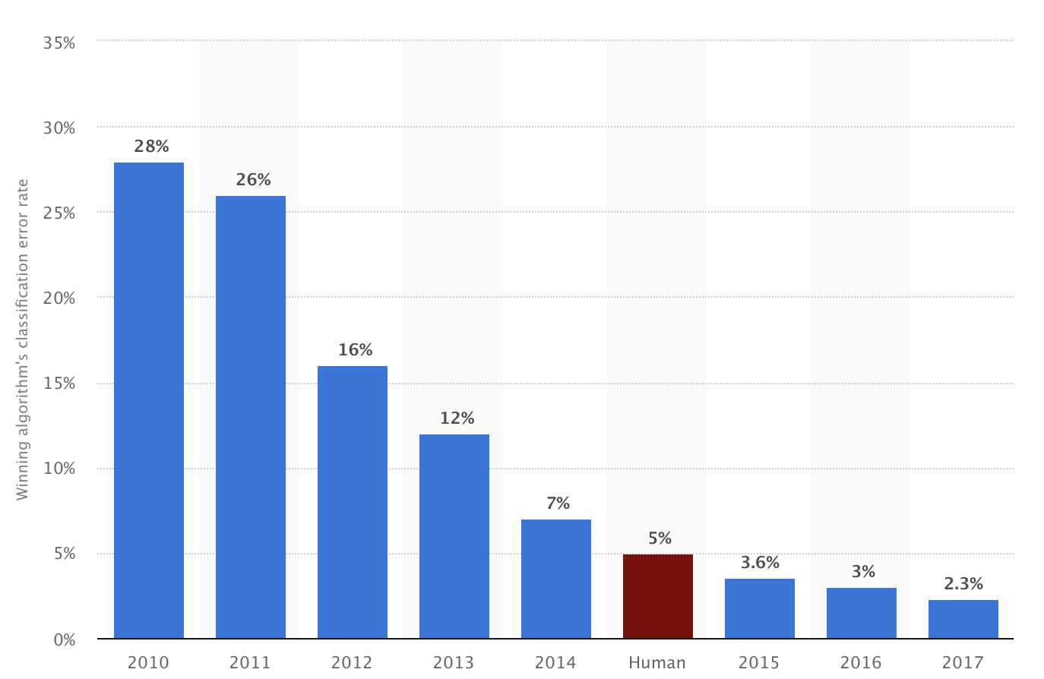
Why Deep Learning
2010 2011 2012 2013 2014 Human 2015 2016
2010 2011 2012 2013 2014 Hum 2015 2016 2017

Slide 18
Why Deep Learning
2010 2011 2012 2013 2014 Human 2015 2016
2010 2011 2012 2013 2014 Hum 2015 2016 2017
Alexnet

Slide 19
Why Deep Learning
2010 2011 2012 2013 2014 Human 2015 2016
2010 2011 2012 2013 2014 Hum 2015 2016 2017
ZF Net:
Tuned Alexnet

Slide 20
Why Deep Learning
2010 2011 2012 2013 2014 Human 2015 2016
GoogLeNet:
AKA “Inception”

Slide 21

Why Deep Learning
2010 2011 20122013 2014 Human 2015 2016
Andrej Karpathy after three days of training!

Slide 22
Why Deep Learning
2010 2011 2012 2013 2014 Hum 2015 2016
ResNet

Slide 23
Why Deep Learning
2010 2011 2012 2013 2014 Hum 2015 2016
Inception-ResNet-v2

Slide 24
Why Deep Learning
2010 2011 2012 2013 2014 Hum 2015 2016 2017
???

Slide 25
How did they do it?
Depth, depth, and more depth!

Slide 26
A Revolution in Depth
AlexNet, 8 layers
(ILSVRC 2012)
Kaiming He, Xiangyu Zhang, Shaoqing Ren, & Jian Sun. “Deep Residual Learning for Image Recognition”. CVPR 2016.

Slide 27
A Revolution in Depth
AlexNet, 8 layers
(ILSVRC 2012)
VGG, 19 layers
(ILSVRC 2014)
GoogLeNet, 22 layers
(ILSVRC 2014)
Kaiming He, Xiangyu Zhang, Shaoqing Ren, & Jian Sun. “Deep Residual Learning for Image Recognition”. CVPR 2016.

Slide 28
A Revolution in Depth
GoogLeNet, 22 layers
(ILSVRC 2014)
AlexNet, 8 layers
(ILSVRC 2012)
ResNet, 152 layers
(ILSVRC 2015)
Kaiming He, Xiangyu Zhang, Shaoqing Ren, & Jian Sun. “Deep Residual Learning for Image Recognition”. CVPR 2016.

Slide 29
A Revolution in Depth
ResNet, 152 layers
Kaiming He, Xiangyu Zhang, Shaoqing Ren, & Jian Sun. “Deep Residual Learning for Image Recognition”. CVPR 2016.
Notes:
It may be apochryphal, but I have heard that North Korea claims to have a 10,000 layer network!

Slide 30
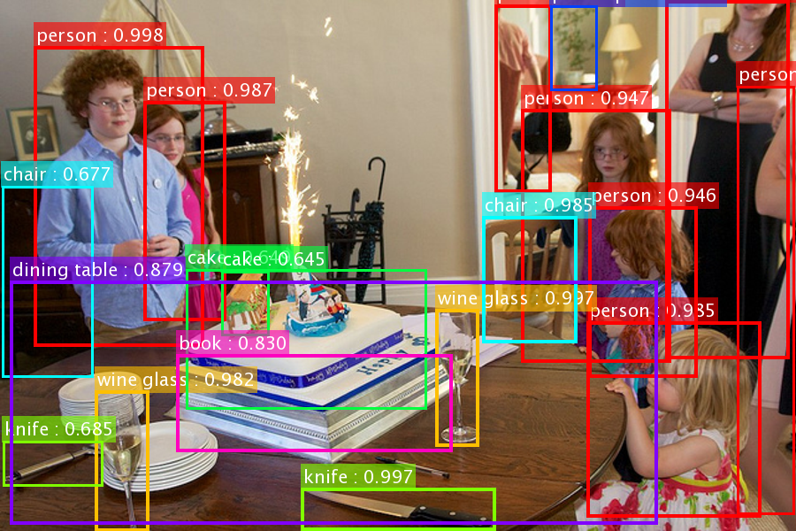
A Revolution in Depth
ResNet’s object detection result on COCO
Kaiming He, Xiangyu Zhang, Shaoqing Ren, & Jian Sun. “Deep Residual Learning for Image Recognition”. CVPR 2016.
Notes:
It may be apochryphal, but I have heard that North Korea claims to have a 10,000 layer network!

Slide 31
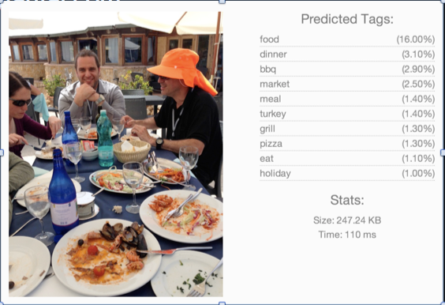
Examples
From Clarifai.com

Slide 32
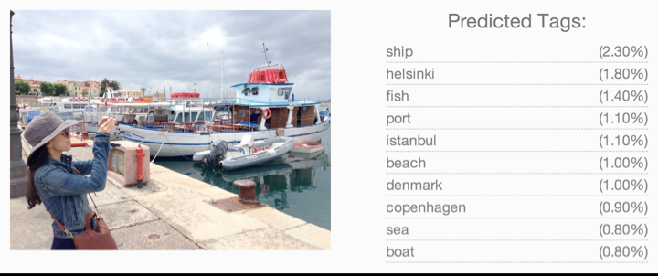
Examples
From Clarifai.com

Slide 33
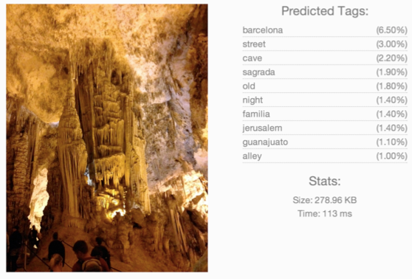
Examples
From Clarifai.com

Slide 34
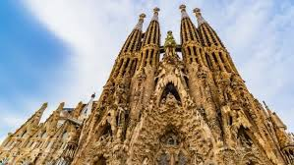
Examples
From Clarifai.com

Slide 35
Overview of Convnets
Feature maps
Feed-forward:
Convolve input
Non-linearity (rectified linear)
Pooling (local max)
Supervised
Train convolutional filters by back-propagating classification error
Pooling
Non-linearity
Convolution (Learned)
Input Image
LeCun et al. 1998

Slide 36
The Details
Operations in each layer
Architecture
Training
Results

Slide 37
Operations in Each Layer
Convolution with learned filters
Nonlinearity
Optional sub-sampling
Notes:
Selection instead of normalization?

Slide 38
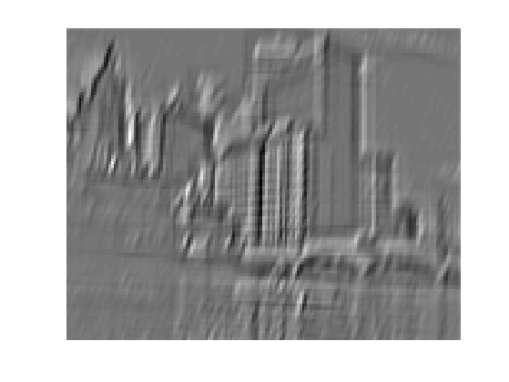
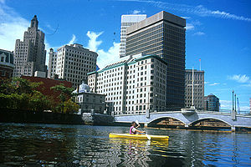
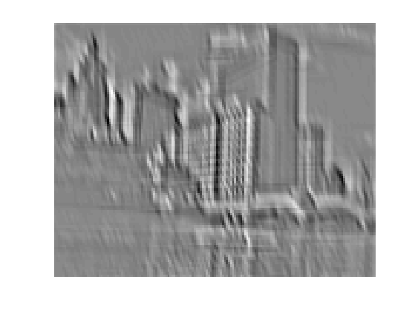
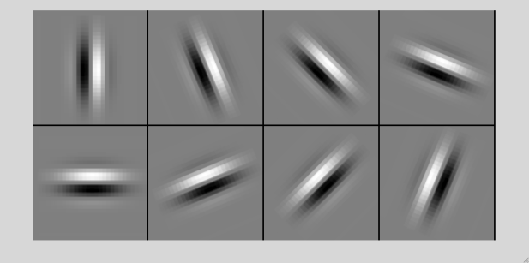
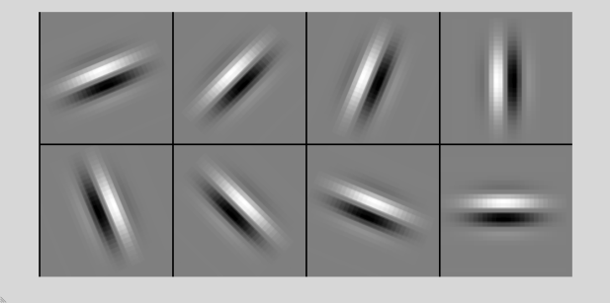
Filtering
Convolution
Filter is learned during training
Same filter at each location
...
Input
Feature Map

Slide 39
Filtering
Local ->
Each unit layer looks at local window
Static statistics ->
Same feature computed everywhere
...
Input
Feature Map

Slide 40
Stop & look at demo...
http://cs231n.github.io/convolutional-networks/#conv

Slide 41
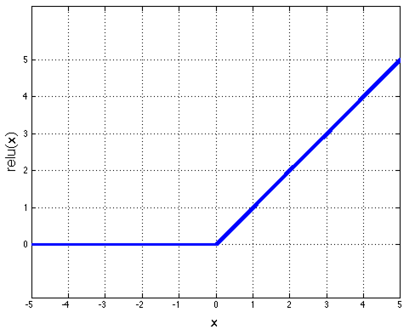
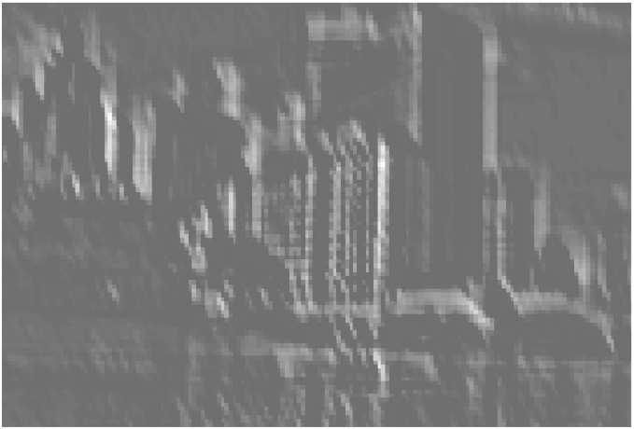
Non-Linearity
Rectified linear function
Applied per-pixel
output = max(0,input)
Input feature map
Output feature map
Black = negative; white = positive values
Only non-negative values

Slide 42
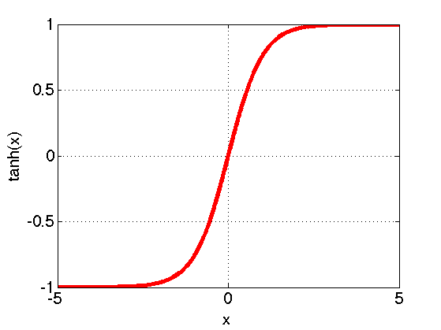
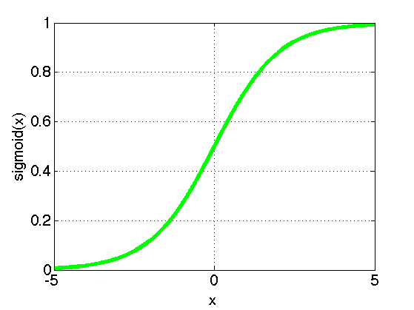
Non-Linearity
Other choices:
Tanh
Sigmoid: 1/(1+exp(-x))
PReLU
[Delving Deep into Rectifiers: Surpassing Human-Level Performance on ImageNet Classification, Kaiming He et al. arXiv:1502.01852v1.pdf, Feb 2015 ]

Slide 43
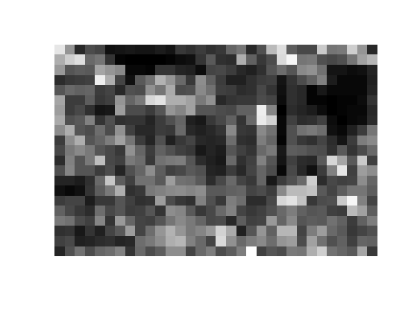
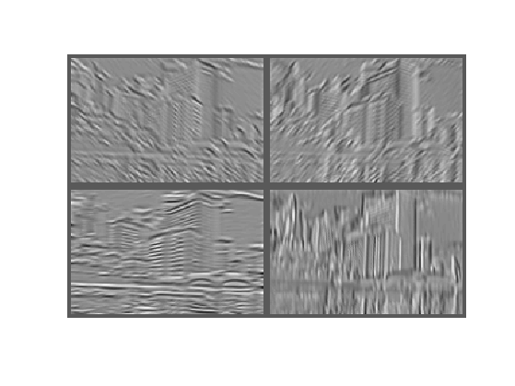
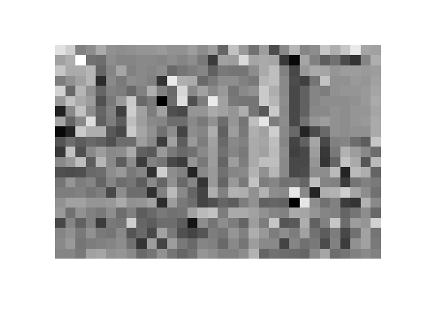
Spatial Pooling
Computation:
Max is best empirically
sum or average used much less
Stride: How far to slide over each time
Tiling is pretty standard – no overlap
Max
Sum

Slide 44
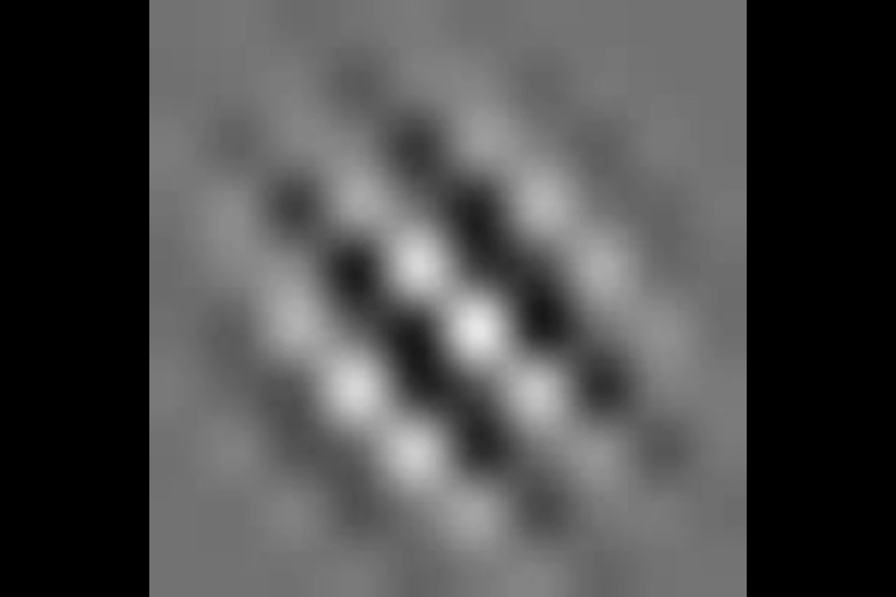
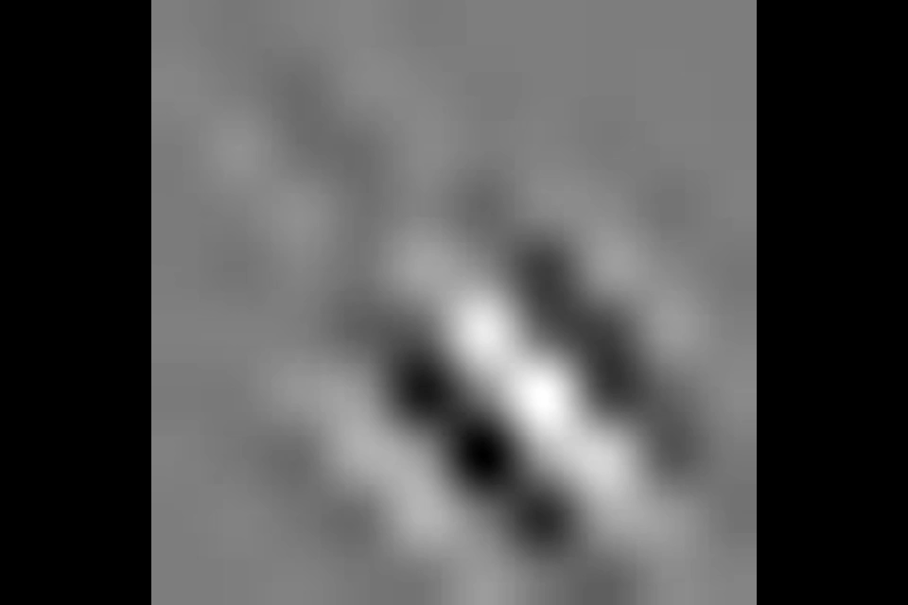
Role of Pooling
Spatial pooling
Invariance to small transformations
Larger receptive fields (see more of input)
Visualization technique from [Le et al. NIPS’10]:
Zeiler, Fergus [arXiv 2013]
Videos from: http://ai.stanford.edu/~quocle/TCNNweb
Notes:
Graph not clear. Explain better. Y-axis is change in value

Slide 45
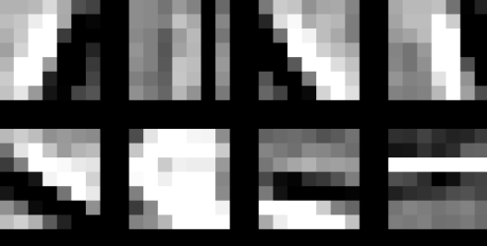
Components of Each Layer
Pixels /
Features
Filter with learned dictionary
Non-linearity
Spatial local max pooling
Output Features
Notes:
Selection instead of normalization?

Slide 46
Normalization across Data
Batch Normalization
[Batch Normalization: Accelerating Deep Network Training by Reducing Internal Covariate Shift, Sergey Ioffe, Christian Szegedy, arXiv:1502.03167]

Slide 47
Overview of Convnets
Feature maps
Feed-forward:
Convolve input
Non-linearity (rectified linear)
Pooling (local max)
Supervised
Train convolutional filters by back-propagating classification error
Pooling
Non-linearity
Convolution (Learned)
Input Image
LeCun et al. 1998

Slide 48
Architecture
Big issue: how to select metaparameters
manual tuning of architectures
Depth
Width, stride, zero-padding of convolutions
Overall parameter count

Slide 49
How to Choose Architecture
Many hyper-parameters:
# layers, # feature maps, params of feature maps
Cross-validation
Grid search (need lots of GPUs)
Better: Random search [Bergstra & Bengio JMLR 2012]

Slide 50
Architecture
Fortunately, some “best practices” on width, stride, zero-padding of convolutions:
Width: 3 (-> 3x3 features)
Stride: 1
Zero-padding: 1
Leads to same size output
If your convolutions don’t “fit” – you may get an error.

Slide 51
Architecture
Stack convolutions, then use max pooling
Why?
Because otherwise you are computing linear features before pooling
So, compute features of features – nonlinear
Then use sampling to change size
E.g., conv->conv->pooling (Alexnet)

Slide 52
But, there’s a better way
“Don’t be a hero” – Andrej Karpathy
Use a pretrained version of the current best imagenet network to extract features
Bolt on a new softmax layer for your problem
Fine-tune it.
Hardly anyone trains a deep net from scratch anymore...
...except you!

Slide 53
How important is Depth
“Deep” in Deep Learning
Zeiler & Fergus ablation study
Tap off features

Slide 54
Architecture of Krizhevsky et al.
Softmax Output
8 layers total
Trained on Imagenet dataset [Deng et al. CVPR’09]
18.2% top-5 error
Layer 7: Full
Layer 6: Full
Layer 5: Conv + Pool
Layer 4: Conv
Layer 3: Conv
Layer 2: Conv + Pool
Layer 1: Conv + Pool
Input Image

Slide 55
Ablation study (Zeiler & Fergus)
Softmax Output
Remove top fully connected layer (layer 7)
Drop 16 million parameters
Only 1.1% drop in performance!
Layer 6: Full
Layer 5: Conv + Pool
Layer 4: Conv
Layer 3: Conv
Layer 2: Conv + Pool
Layer 1: Conv + Pool
Input Image

Slide 56
Ablation study (Zeiler & Fergus)
Softmax Output
Remove both fully connected layers
Layer 6 & 7
Drop ~50 million parameters
5.7% drop in performance
Layer 5: Conv + Pool
Layer 4: Conv
Layer 3: Conv
Layer 2: Conv + Pool
Layer 1: Conv + Pool
Input Image

Slide 57
Ablation study (Zeiler & Fergus)
Softmax Output
Now try removing upper feature extractor layers:
Layers 3 & 4
Drop ~1 million parameters
3.0% drop in performance
Layer 7: Full
Layer 6: Full
Layer 5: Conv + Pool
Layer 2: Conv + Pool
Layer 1: Conv + Pool
Input Image

Slide 58
Architecture of Krizhevsky et al.
Softmax Output
Now try removing upper feature extractor layers & fully connected:
Layers 3, 4, 6 ,7
Now only 4 layers
33.5% drop in performance
Depth of network is key
Layer 5: Conv + Pool
Layer 2: Conv + Pool
Layer 1: Conv + Pool
Input Image

Slide 59
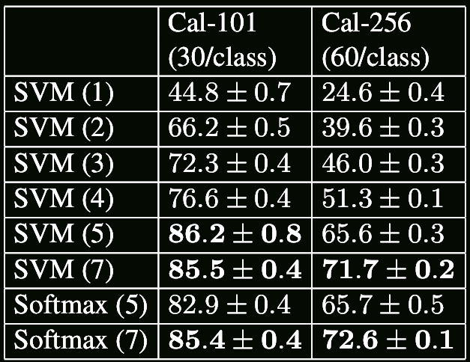
Tapping off Features at each Layer
Plug features from each layer into linear SVM or soft-max

Slide 60
Summary
Convnets use four principles:
Pixels depend on nearby pixels (locality): Hence, small receptive fields
The statistics of visual inputs are invariant across images (stationary statistics): Hence, replicate receptive fields across images
Objects don’t change identity based on location: translation invariance: Spatial pooling
Objects are made of parts: receptive fields get larger deeper in the net
Their structure is comprised of:
A convolutional layer of replicated feature maps (usually small features, e.g., 3X3)
A nonlinearity applied to these (usually ReLU)
An optional pooling layer, usually max pooling, usually 2X2
Batch normalization

Slide 61
Summary
Depth matters. Depth allows features of features of features to be learned, which tend to get more abstract in deeper layers.
Deeper networks are usually better, as long as they allow the gradient to pass backwards easily (deep supervision, skip connections, as in Residual Networks)
It is often best to simply re-use a pre-trained network to compute the features of the images, and then add a softmax for categorization, or logistic units for tagging (multiple tags, as in Clarifai example).

